Slide 1
Guidelines for Visualization
Notes:
When it comes to communicating the findings from your data analysis, visualizations are absolutely central.

Slide 2
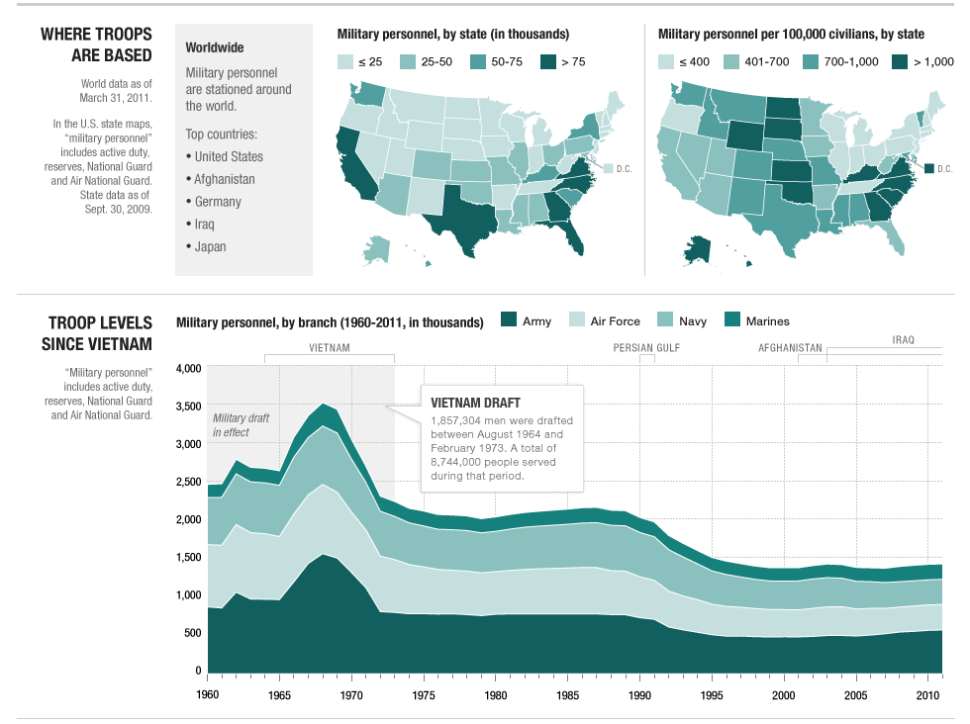
Notes:
Graphs can capture so much detail and make it digestible in a way that numbers can’t.
They can generate interest in your work and make people want to dig in further.
They can leave the reader with a lasting impression of some features in the data.

Slide 3
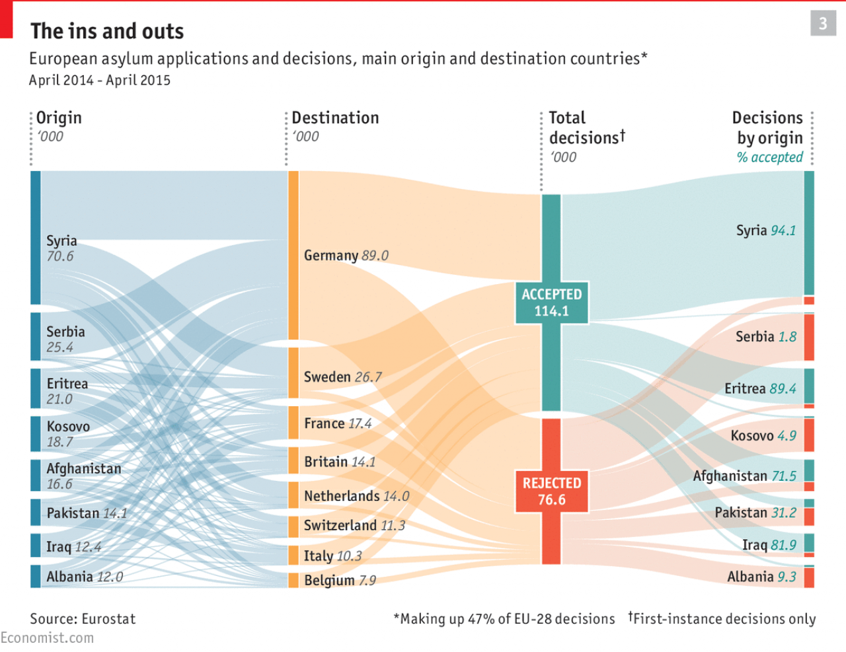
Notes:
Graphs can capture so much detail and make it digestible in a way that numbers can’t.
They can generate interest in your work and make people want to dig in further.
They can leave the reader with a lasting impression of some features in the data.

Slide 4
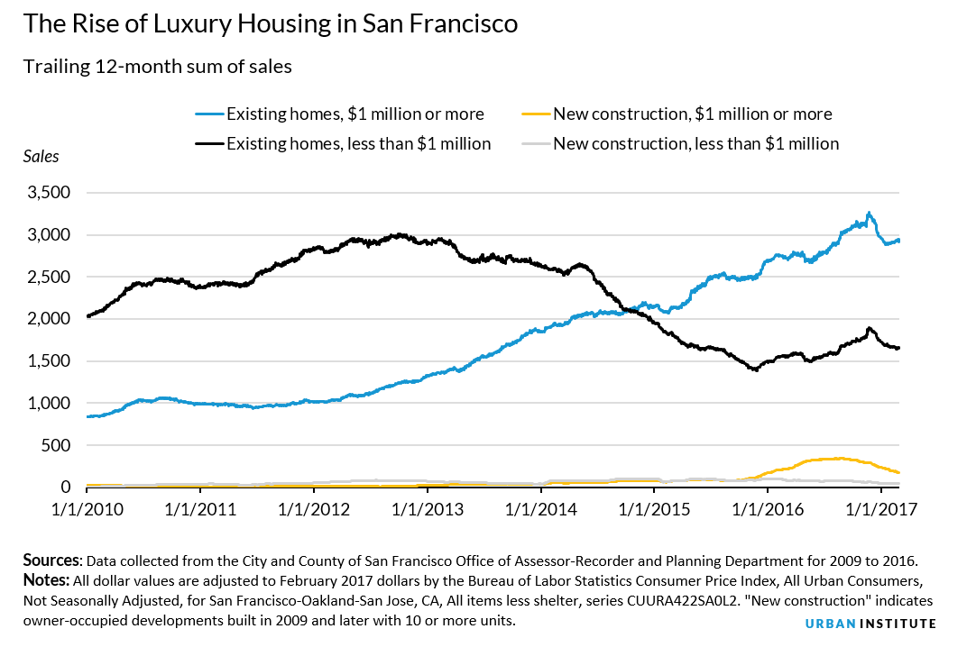
Notes:
Graphs can capture so much detail and make it digestible in a way that numbers can’t.
They can generate interest in your work and make people want to dig in further.
They can leave the reader with a lasting impression of some feature in the data.

Slide 5
Plotting is Hard
Graphs aren’t standard.
Our eyes can fool us.
Data can be distorted.
Notes:
At the same time, making effective, honest, accessible (and even beautiful) visualizations is hard.
Graphs aren’t standard in the way that numerical summaries are.
Lots of choices to make.
Need to balance competing aims.
Our eyes can fool us.
Consider the limits of our visual system
Potential to distort the data – you could even say to lie - but also to bring important features to the attention of the reader, and to form a lasting narrative.

Slide 6
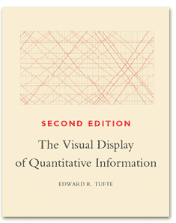
Notes:
It’s not easy to distill good visualization into a set of rules.
One of the most influential writings about creating visualizations:
The Visual Display of Quantitative Information, Edward Tufte 1983
According to Tufte, there are certain qualities that visual displays should adhere to.
The list (from his first chapter) is worth reading in full.

Slide 7
Tufte: Graphical Displays Should…
Show the data
Induce the viewer to think about the substance rather than about methodology, graphic design… or something else
Avoid distorting what the data have to say
Present many numbers in a small space
Make large data sets coherent
Encourage the eye to compare different pieces of data
Reveal the data at several levels of detail…
Serve a reasonably clear purpose…
Be closely integrated with the statistical and verbal description of a data set
Notes:
If you haven’t made many visualizations, this list might seem abstract at first.
The more time I spend working with data, the more I appreciate how well curated these principles are - and I find them to be increasingly actionable
We’ll go into some examples that highlight some of these principles, and show you how to apply them in your own work.

